Slide 1


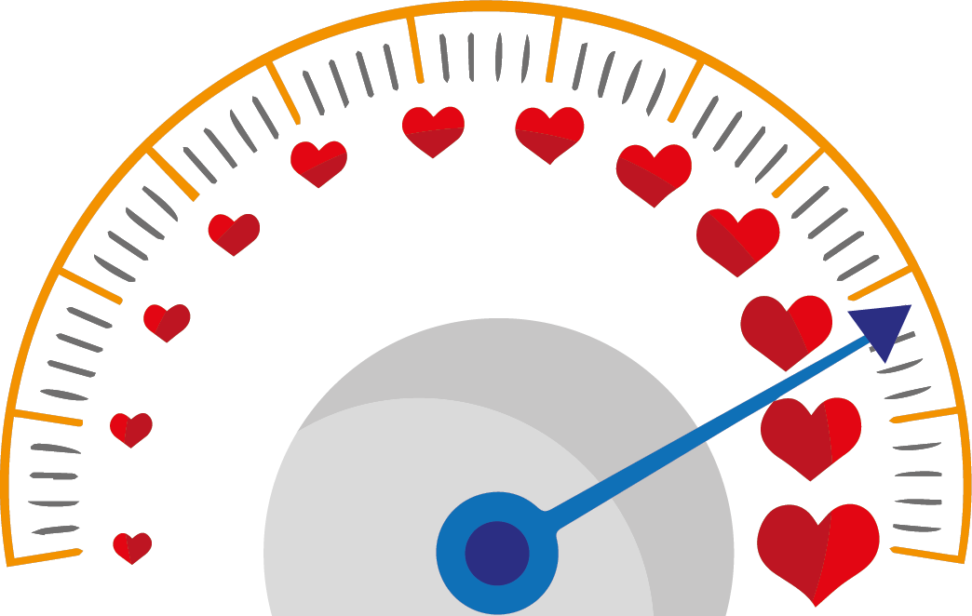



Everything Jesus taught us is aimed at giving us, with all his love,
THE TOOL WE NEED TO ACHIEVE THE GREATEST POSSIBLE UNITY AMONG US AND WITH GOD.
If there is one word that describes the very essence of God REVEALED TO US in Jesus Christ, this word is:
WORD
of
LIFE
MerCY!
Therefore, we can say that
MERCY is LOVE that
DOES NOT MEASURE.
IT IS ABUNDANT,
DIRECTED TO EVERYONE
AND CONCRETE.
MERCY IS THE ULTIMATE,
the greatest expression of love, of charity. Mercy completes love and makes it perfect.
LOVE «WITHOUT MEASURE»
What is mercy? What does it mean?
How can we live well this Word of Life?
Yes! But, above all, loving in this way tends to bring about RECIPROCAL LOVE. This is the final goal of MERCY because without this mutual love, there would only be justice, which creates equality but not BROTHERHOOD.
11
In the «OUR FATHER»,
Jesus mentions it,
using other words,
but it’s always about mercy.
By trying to love and
TO BE MERCIFUL
in EVERY RELATIONSHIP
with other people.
“BLESSED ARE THE MERCIFUL, FOR THEY WILL RECEIVE MERCY.”
“FORGIVE US OUR DEBTS
( MEANING OUR FAILURES
TO LOVE OTHER PEOPLE)
As we forgive our debTors
(in the sense that we too forgive those who hurt us in some way)”.
BEING MERCIFUL MEANS TO WELCOME EACH PERSON WE MEET, INCLUDING THE POOREST AND THOSE MOST IN NEED.
centrogen3.rpu@focolare.org
Adapted byTeens4Unity from the
Word of Life written by Letizia Magri
(Mt 5:7)

