Slide 1



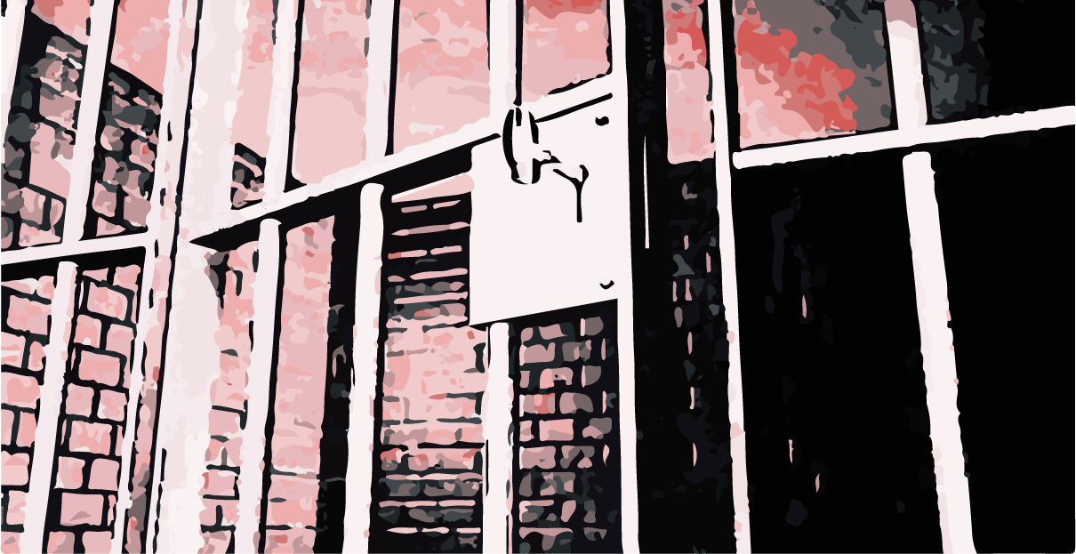

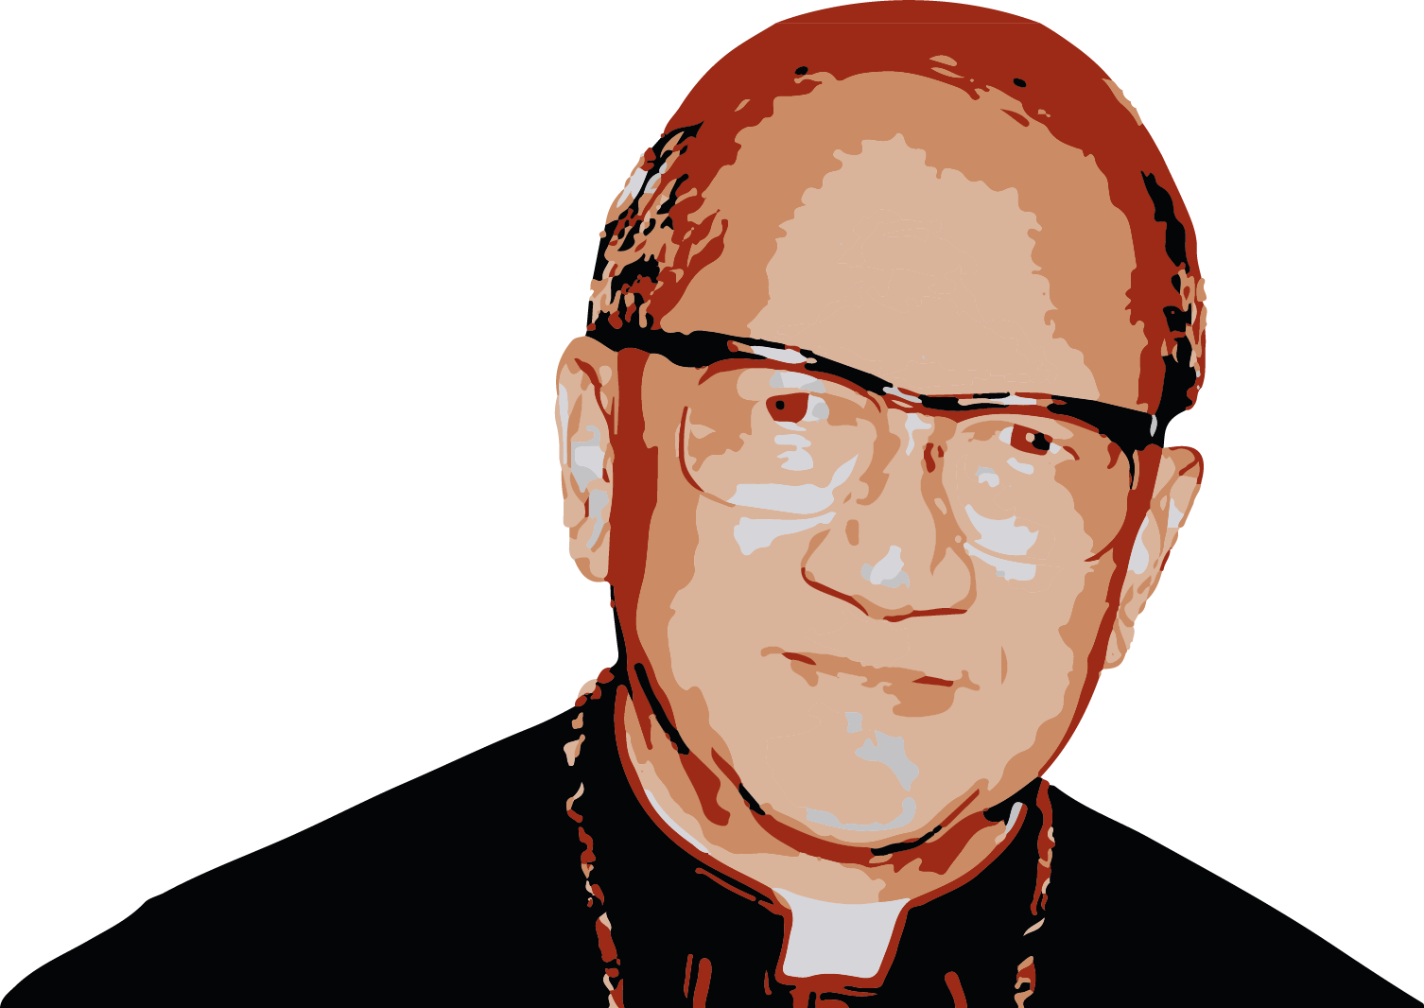
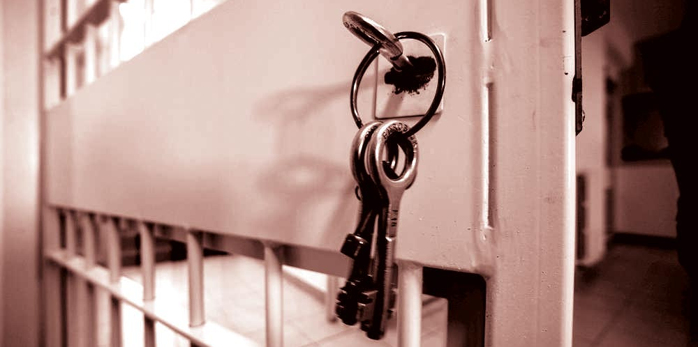

This month we present the experience of Cardinal
Franҫois van Thuân,
who was from Vietnam and spent
13 years in prison, 9 of which were in solitary confinement.
He gave witness to the truth that when love is sincere and without any self-interest, others respond with love, too.
They finally decided to leave the same guards all the time because otherwise he would have converted all the police in the prison!
«Make yourself one,"
«Live what the other is living."
Or, as we often say:
«Put yourself in the other person’s shoes."
Share their life with them...
WORD
of LIFE
9
“Serve
out of love"
«At first the guards would not speak to me. They only answered yes or no. One night I got an idea. I told myself, ‘Franҫois, you are still very rich because you have the love of Jesus in your heart. Love them like Jesus loved you!’
The next morning I started to love them even more than before, seeing Jesus in each one, smiling at them and speaking kindly to them».
Let’s learn to listen carefully to the voice of God in the depths of our heart. This is the voice of our conscience. It will tell us what God wants of us in every moment. It will help us know how to love our neighbour and how to bring them to experience God’s great love for them.
“ For though I am free with respect to all, I have made myself a slave to all, so that I might win more of them!”
When he was in prison, he had five guards, but every two weeks the directors of the prison had to change them for another group of five because they would get «contaminated» by the love of the bishop.
centrogen3.rpu@focolare.org
(1Cor 9:19)
Adapted by Teens4Unity from the
Word of Life written by Letizia Magri

