Slide 1





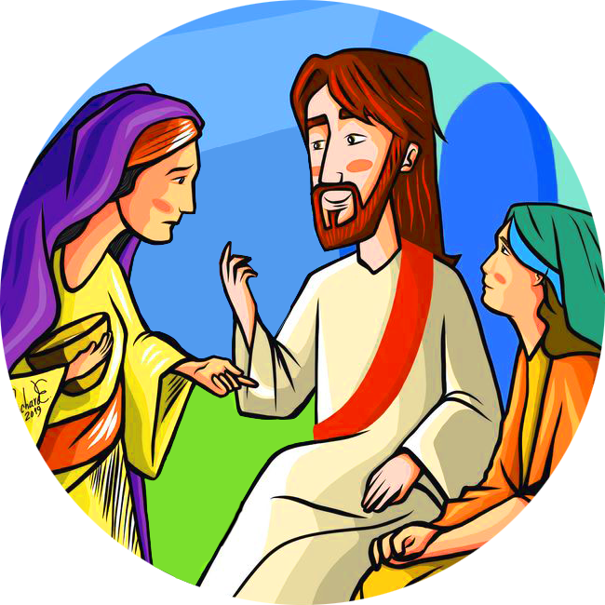

Hi! Did you read the story where this phrase comes from?
It’s in the Gospel of Luke, chapter 10.
This chapter from the Gospel invites us to welcome others not only in our own house, with concrete acts of love, but also by making room for them in our hearts.
Does it happen to you, like it does to me, that I have so many things to do and I don’t know how to distinguish between what is urgent and important to do and what is not?
The characters in the story are
MartHa and Mary.
You can tell that they are friends of Jesus from the way they talk to him.
What I learned from this Word of Life is that the best attitude to have in following Jesus is to stay close to him,
without worrying too much about what
we should do or say or give, because
«there is need of only one thing.»
7
Both of them welcome Jesus
who was visiting them,
but they do it in different ways.
This is possible if we have a strong friendship with Jesus which makes us capable of loving as he does and able to give his love and kindness to everyone we meet.
Word
of
LIFE
« There is need of only one thing»
Mary sits down at the feet of Jesus, listening to him, and instead Martha is very busy preparing the food
to offer to him.
The Word of Life
is like a seed.
«May prayer and action
always be deeply united»
“A prayer that does not lead you to do something concrete for your neighbour – the poor, the sick, those in need of help, someone in trouble – is a sterile and incomplete prayer.»
They show us two ways to LOVE:
1-LOVE GOD
by listening to what he says.
2-LOVE OUR NEIGHBOURS
by serving them.
When we accept in our hearts the words of the gospel, we allow them to transform us.
(Lk 10:42)
«But at the same time, when (…)
you only pay attention to doing things, you tend to give importance to organizing everything and being in charge, and you forget that Christ should be at the centre of it all. You don’t take the time to have a conversation with him in prayer.
You risk serving yourself and not God present in your neighbour who needs your help».
Pope Francis at the Sunday Angelus, July 21, 2013
Not only. If we are faithful and keep them in our heart and live them every day, they will make our life into something extraordinarily beautiful, just like a seed that is buried in the ground begins to grow and then produces fruit.
These are not two opposite ways to love,
but rather they complement each other
because it’s the same Love in both of them.
V. F. Sanchez
centrogen3.rpu@focolare.org
Make room in my heart for the other person.
I can use my time well.
Adapted by the International Centre
of the Teens4Unity from the
commentary by Letizia Magri.

