Slide 1




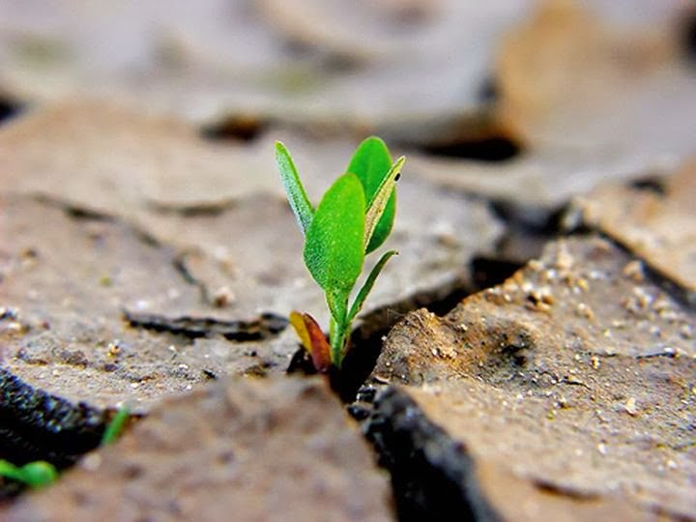
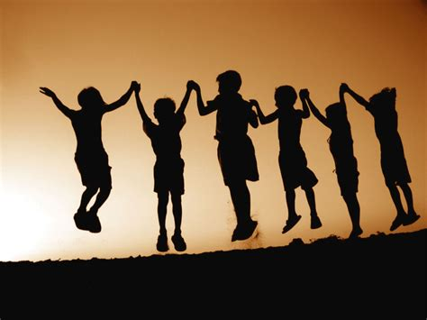
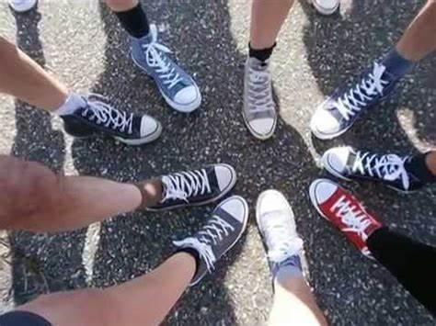

What does it mean to seek the things that are above?
«What does ‘the things that are above’ mean in this Word of Life?»
And how can we keep our hearts anchored to heaven when we live in the midst of the world?
It means that in your life you should aim at God and what concerns him.
Jesus brought on earth the life of heaven. When he rose from the dead on Easter, HE BROUGHT ABOUT A NEW CREATION.
It means all those values that Jesus brought on earth and characterize his followers, like:
mutual love,
peace,
forgiveness,
purity,
honesty,
justice, and so on.
«By allowing ourselves to be guided by the thoughts and feelings of Jesus, whose inner gaze was always turned towards his Father and whose life reflected, in every moment, the law of heaven, which is the law of love»¹.
( ¹ Chiara Lubich, Word of Life, April 2001 )
«Set your minds on things that are above and not on things that are on earth»
(Col 3:2).
What are the consequences of choosing to live the Gospel?
The words of the gospel offer us many good values, and we should put them into practice.
By living them, we can fulfill ourselves as people who are truly risen with Jesus. We will realize that we have never been happier than when we live like this.
Living with Jesus, our life will change.
Beyond all failures, evil or violence, beyond everything we might suffer, Jesus is risen and he is the one who directs the history of the world, as well as each one of our individual lives.
WORD of LIFE
Living the Gospel is a choice that totally changes our way of thinking. It turns upside down our idea of what is a good model to follow, as well as the goals proposed to us by the world around us. It frees us from the influence of others. We are totally changed!
4
Aim high
in life
centrogen3.rpu@focolare.org
Adapted byTeens4Unity from the
Word of Life written by
Patrizia Mazzola and her team

