Slide 1






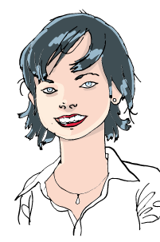

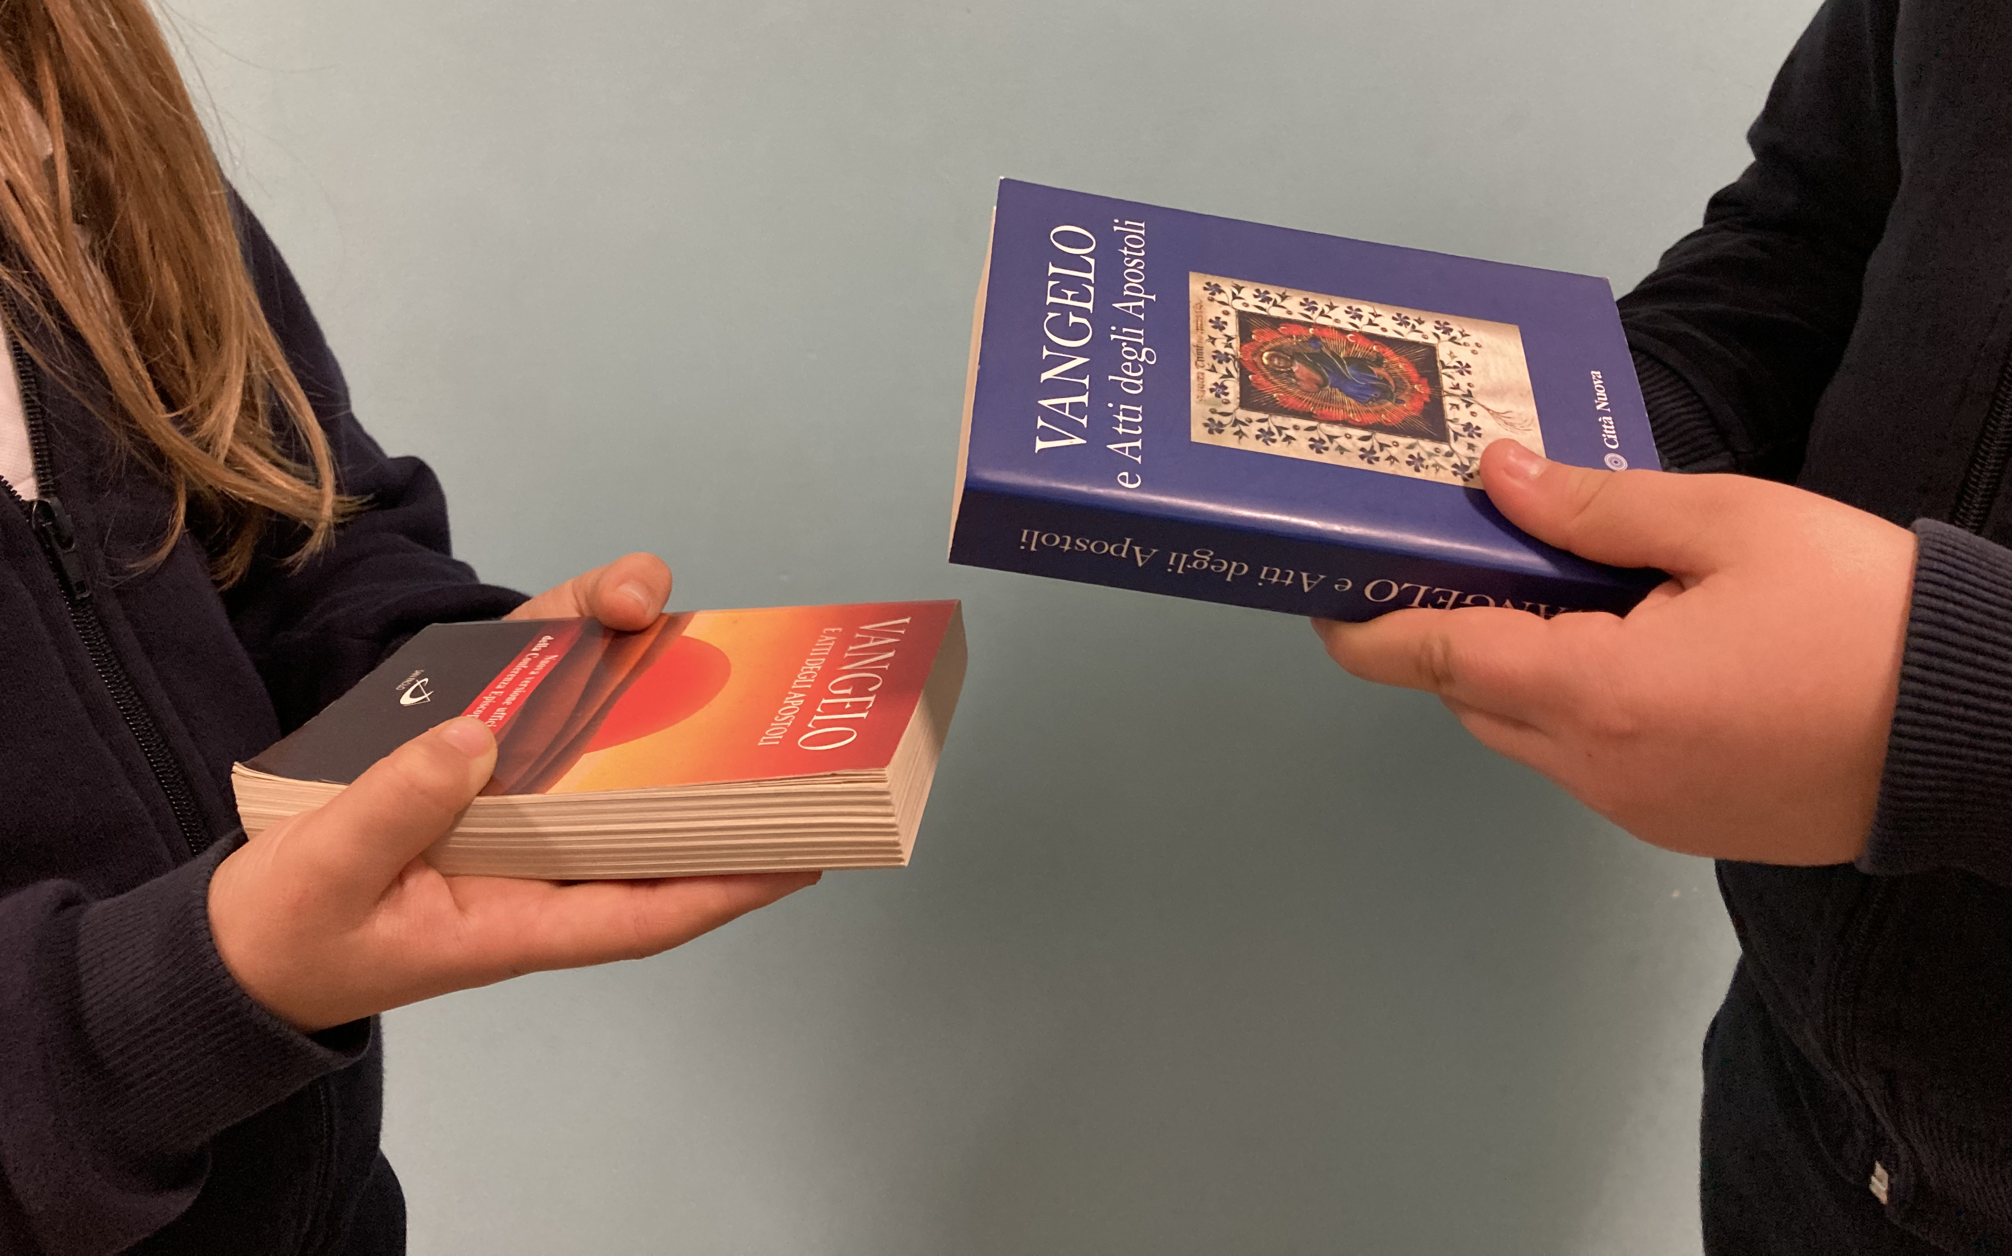

We Christians of the 20th century are called to «BE LIGHT»!
However, we might feel inadequate, conditioned by our limitations, or even influenced by external circumstances.
LIVING the WORD
TO LIVE THE GOSPEL
3
Living the Word of Life totally changed my way of seeing things. Now I try to see the positive in everything that happens.
Something happened at school that really made me very happy! Our math teacher passed out our homework and I got «7» (the highest grade is «10») which made me very happy because I had never received such a good grade in math!
“Live as
children of light…”
(Eph 5:8-9)
How can we go forward with hope, even though at times we feel overwhelmed by fear?
«We become holy by living the Gospel.
So I want to hand on to you not only some words of encouragement, but the actual Gospel itself.
This is the gift I want to give you.
The Gospel is, and always will be, the book that will renew individuals and the whole of society. We need to be nourished by it from the time we are young in order to become holy and change the world.
My wish for you is that you live the Gospel so well that anyone who sees you can say: «There goes another little Jesus passing through the world»¹.
We have to follow the path of continually growing in our knowledge of God and of his will, which is full of love for each of us.
And WE HAVE TO START OVER AGAIN EVERY DAY!
Saint Paul invites us to live our daily life in harmony with the call we received from God. He tells us:
«BE IMITATORS OF GOD, AS VERY DEAR CHILDREN».
This MEANS TO BE HOLY AND FULL OF MERCY FOR ALL.
But when I looked over my work, I saw that there was a mistake that the teacher had not noticed and would have lowered my grade. As soon as I realized it, I told my teacher. I actually felt even happier by telling her! My classmates couldn’t understand why I did that, but for me the grade wasn’t as important as being ready to live in truth and love, and nothing else.
What is it that gives us true joy?
WORD of LIFE
In that moment I felt so free and fulfilled, like a mature Christian. One of my classmates suggested that the teacher lower my grade by only half a point, but the teacher decided to leave my grade at 7, because I had acted justly and told the truth.
It’s living the Word of God! That is what gives us light and makes us capable of giving witness to GOODNESS, TRUTH and JUSTICE in our troubled world.
“… for THE FRUIT OF THE LIGHT
IS FOUND IN ALL
that is good and right and true.”
This month let’s share our Bibles with each other, or give the Gospel to someone,
and make the commitment
to live together what it says.
Did you ever ask yourself:
“What would Jesus do
if he were in my place?”
For me it was like an affirmation that I had acted well and made me the happiest girl in the world!
¹⁾ «Handing over the Gospel,» Chiara Lubich to the Gen 3
centrogen3.rpu@focolare.org

