Slide 1

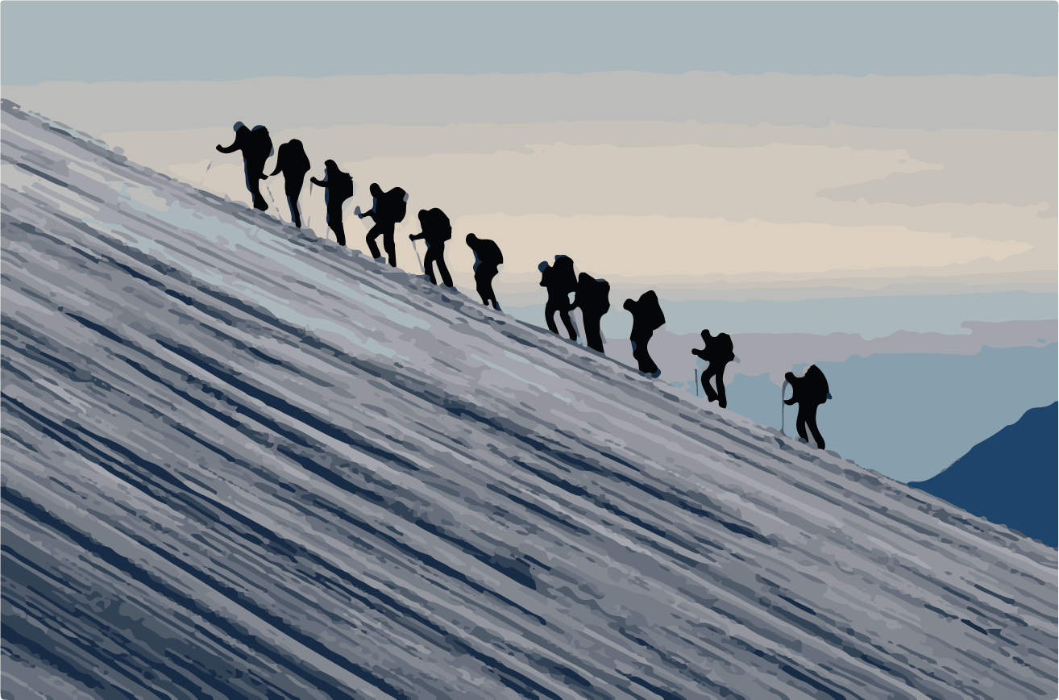



2
LIVING the WORD
«When we are convinced that God loves us,we can become
We can face the difficulties together and discover in them the presence of God guiding our life, which will also help us to continue with confidence along our journey.
WORD of LIFE
I realized that one of my classmates was often all alone, especially during recess.
One day I decided to invite her to play with us, but she didn’t accept.
messENGERS OF HIS LOVE,
giving his love to many other people»
«We are called
to see
what others need,
to help our neighboUrs
whenever they experience hardship,
to share
both their joy
and their sorrow».
(See Genesis 16:13)
«You are the God who sees me».
During an outing with the class, I happened to sit next to her on the bus. On the way we exchanged only a few words. I resisted the temptation to move to another seat where I would be with the group of my close friends.
Then I decided to spend the whole day with her, so that I could be a small sign of God’s love. On the ride home it was the same – many moments of silence between us.
As a gift to one another, let’s remember and share those moments when we experienced the love of God for us and felt a very special joy. It is these moments that help us understand the true meaning of life.
This word of Life renews our trust in god and gives us comfort.
we are
never alone
on our journey.
God loves us and is always with us.
When we got back to school, the way she said goodbye surprised me. She said: «Thank you for not leaving me alone.» Later she invited me to come to her house, and with some of my friends we went to play with her.
Our task is to
KEEP OUR EYES OPEN
TO ALL THE PEOPLE
AROUND US,
to everyone in the world.
centrogen3.rpu@focolare.org
Adapted byTeens4Unity from the
Word of Life written by
Patrizia Mazzola and her team

