Slide 1

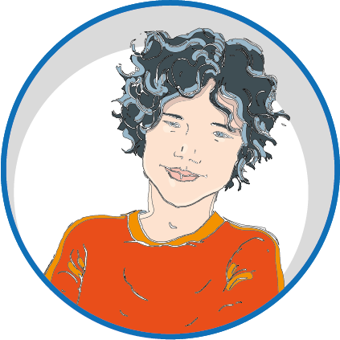

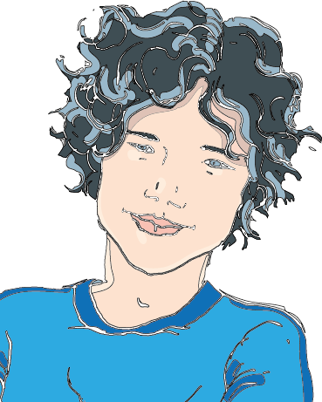
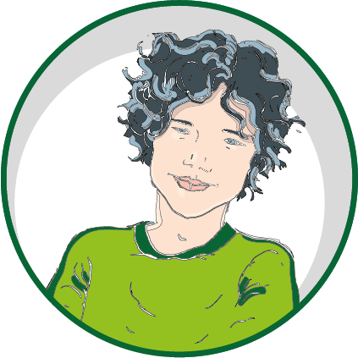

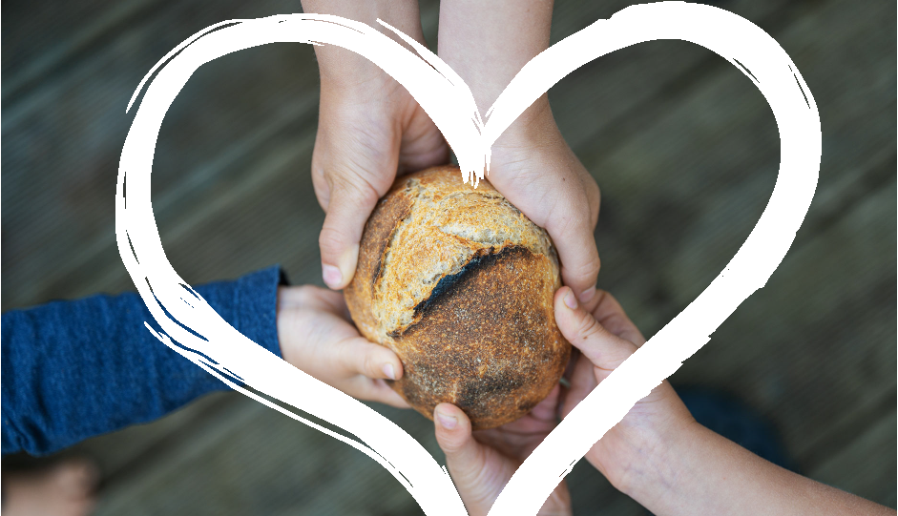
WORD of LIFE
TALKING ABOUT JUSTICE
IS A HOT TOPIC.
Inequality, violence and prejudice continue to spread in every area of society. It’s hard to give witness to a culture of peace and unity.
«Without love, there will never be true justice, a sharing of goods between rich and poor, respect for the uniqueness of each human being and attention to their concrete situations.»
What does it mean
to «seek justice»?
1
«learn
to do good;
seek justice».
Chiara Lubich, Word of Life, November 2006
(Isaiah 1:17)
How can we
learn to do
what is good?
Living for a united world means helping to heal the wounds of humanity through small gestures that can create the sense of a «family» among everyone.
It’s like a treasure that you really want and so you look for it.
It’s the goal of all your actions.
We have to take the position of
wanting to learn!
And this means we have to make the effort.
This word of life urges us to help others, to be attentive to them and assist them in concrete ways when they need something.
«When faced with concrete and urgent needs, we need to act quickly. How many people in our world look forward to a visit from someone who is concerned about them! How many of the elderly, the sick, the imprisoned and refugees need a look of sympathy from us, a visit from a brother or sister who scales the walls of indifference!»
Every day we always have something new
to understand
and to improve.
But we can always
start all
over again
if we fail.
Pope Francis’ Message to Young People for the World Youth Day, Lisbon 2023
Acting JUSTLY HELPS US
TO LEARN HOW TO DO
WHAT IS GOOD.
This means welcoming God’s will for us because it is our true good.
It requires that we open our hearts, our minds and our hands, reaching out especially to those who are suffering.
centrogen3.rpu@focolare.org
Adapted byTeens4Unity from the
Word of Life written by
Patrizia Mazzola and her team

