Slide 1


Mark (Italy)
John Victor (Brazil)
Christopher (Panama)
Davide (Italy)
André (Portugal)

Slide 2
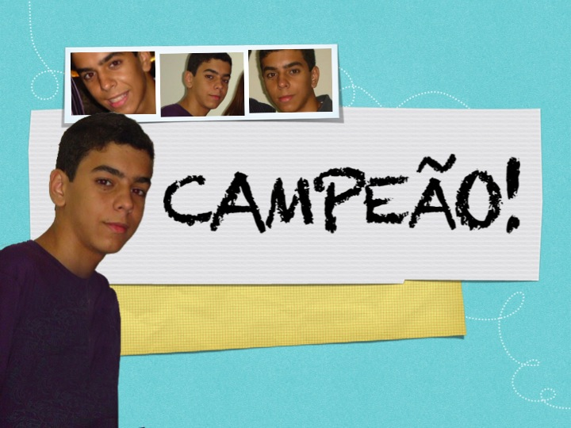
CHAMPION!
John Victor (Brazil)

Slide 3
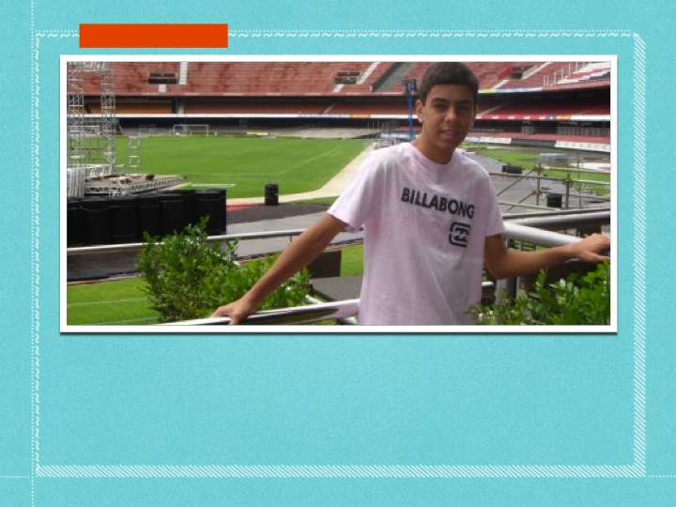
On December 20, John Victor left for heaven. He was a gen 3 from Aracaju, Brazil.

Slide 4
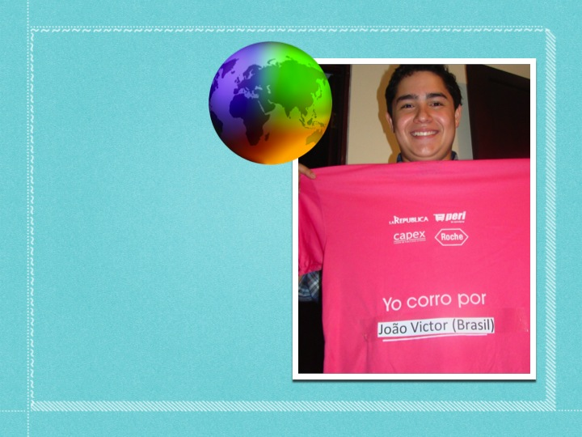

The Gen 3 all over the world prayed for him.
Gabo from Costa Rica ran in a race to raise funds for his medical expenses.

Slide 5
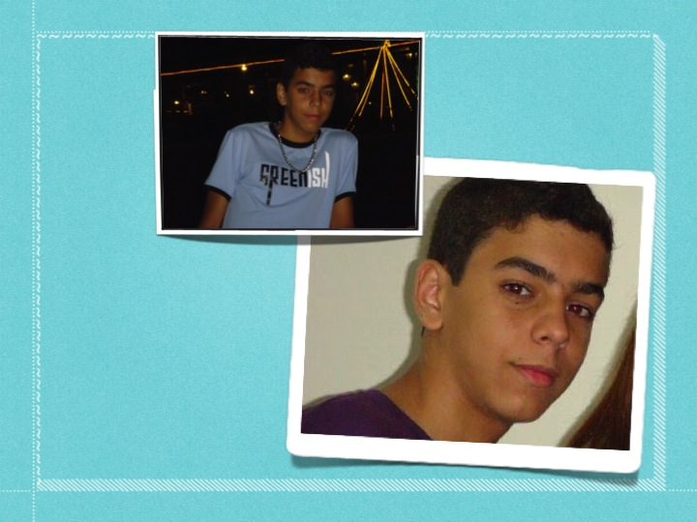
Everyone who knew him agreed that John Victor was really ready for his special meeting with Jesus.

Slide 6
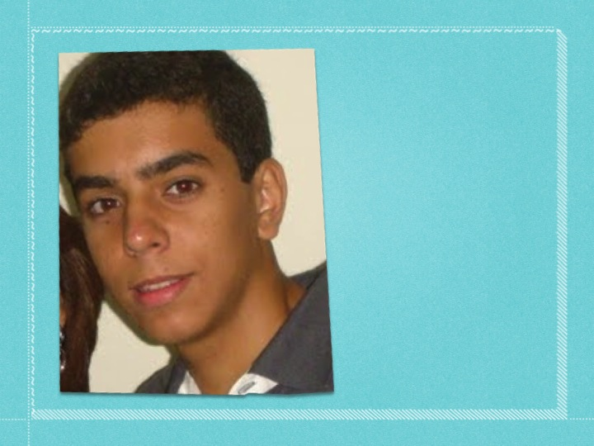

During the entire period of his illness he and his family formed a close bond with Jesus Forsaken.

Slide 7
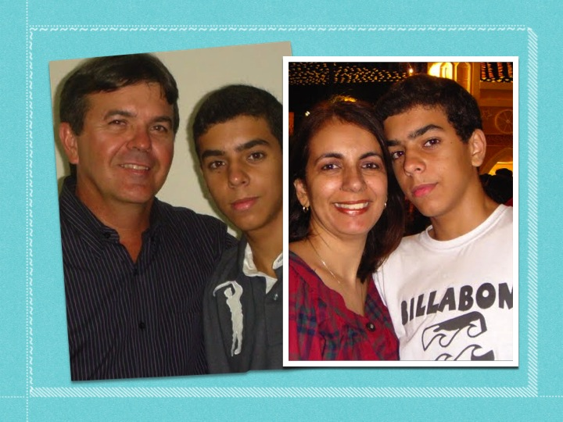

Slide 8
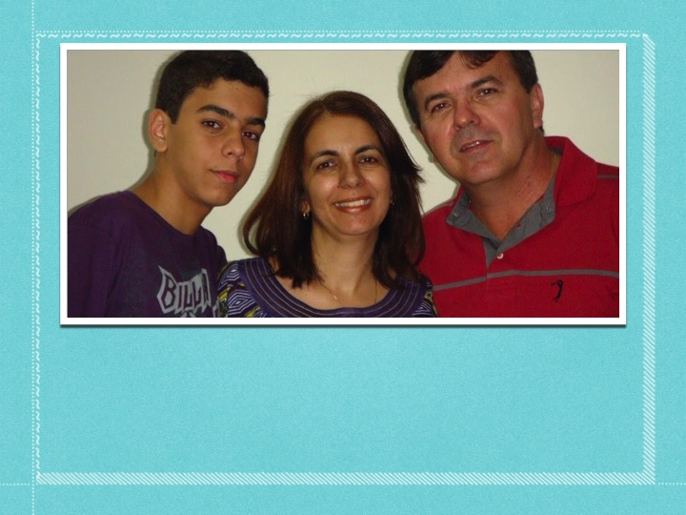

When his father told him that his "departure" was near, he smiled and asked his parents to say goodbye to everyone for him - his relatives, schoolmates and friends.

Slide 9
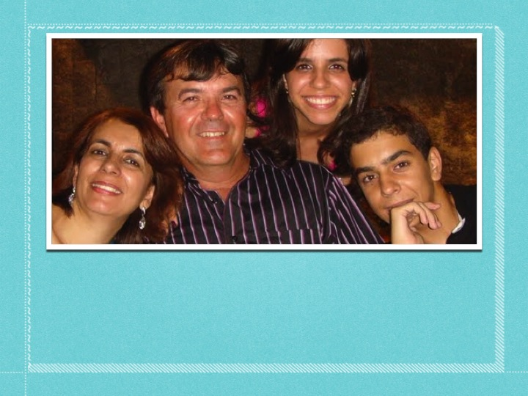

They also told him that soon he would be meeting with Jesus and Chiara, and that made him very happy. He left very peacefully for heaven.

Slide 10
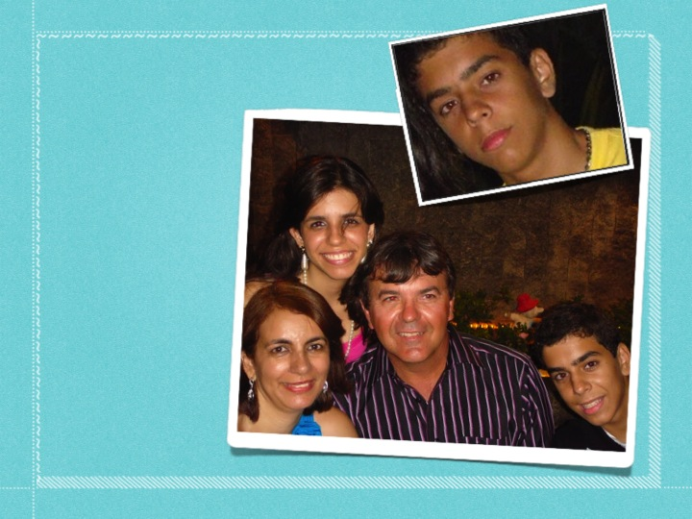
Now we have another little saint in heaven! We can ask him to help us to live as true gen.

Slide 11
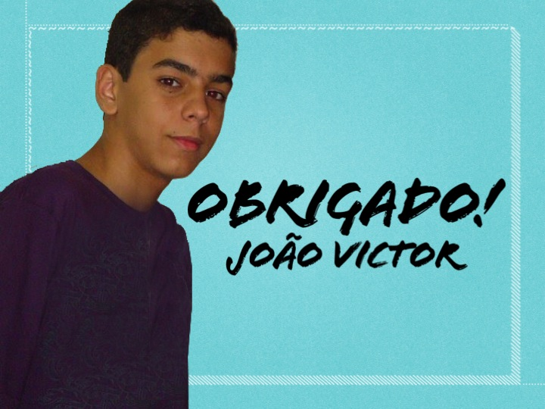
Thank you!
John victor

Slide 12
Mark (Italy)
John Victor (Brazil)
Christopher (Panama)
Davide (Italy)
André (Portugal)

Slide 13
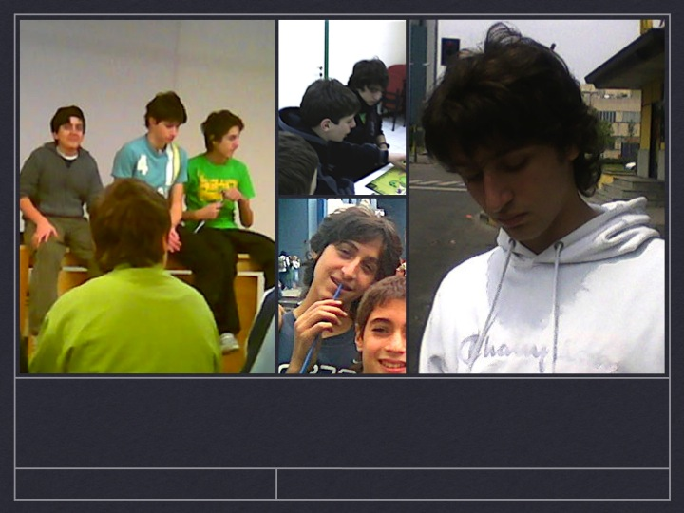
DAVIDE
“MY RELATIONSHIP WITH GOD”
MY MEETING WITH JESUS FORSAKEN

Slide 14
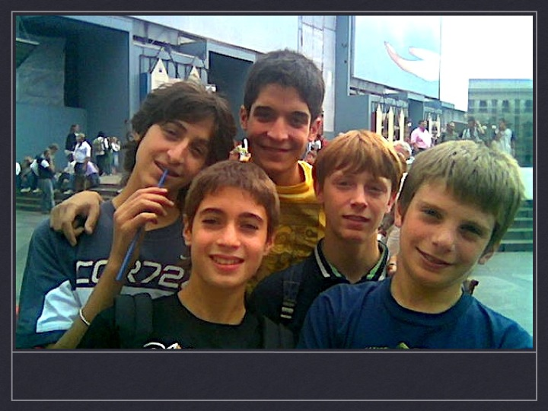
Davide was part of our Gen 3 unit. I remember that in the beginning it was not always easy among us, because we all had different characters, styles and ways of thinking.

Slide 15
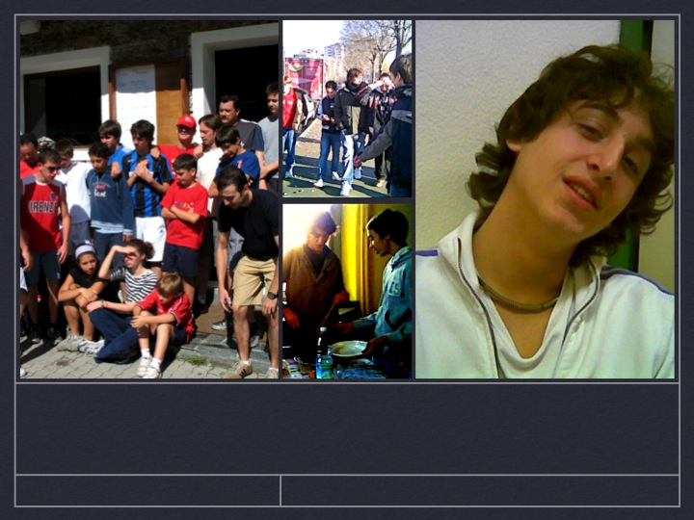
Davide was also our “white.” He looked after the other gen 3 with lots of love and always tried to tell them in a constructive way about the things that were going well and those that could be changed.

Slide 16
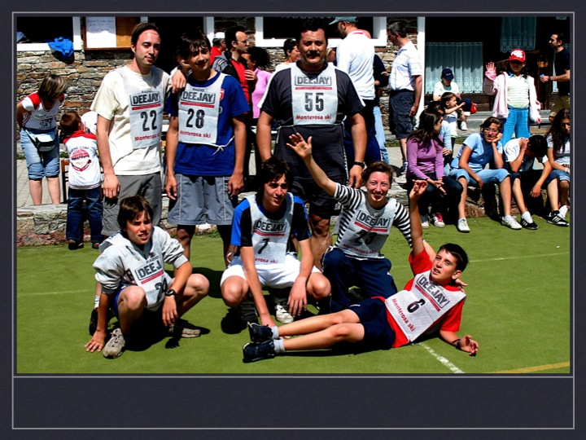
The Gen 3 School in Loppiano was an important moment for him. When he went back home, he was totally committed to living the gen life.

Slide 17
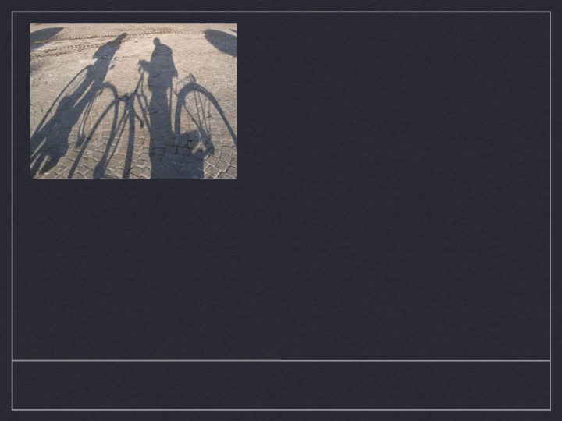

At the end of the school year he asked me to take a ride with him. At a certain point we stopped and he told me that he had not passed and would not be promoted to the next class.
I could see that it was very hard for him. He told me that none of his friends knew yet.
He felt like a real failure.
We talked for a while and I asked him if he felt free to share this experience at our gen unit meeting. He thought a little while and then said "yes."

Slide 18
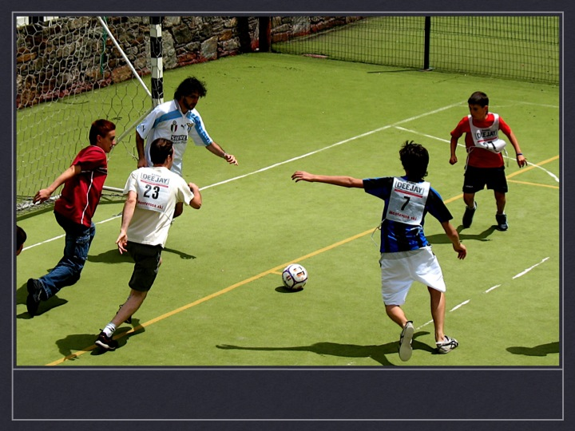

Slide 19
The result was a greater communion among us in our gen unit.
At first the gen would share some small thing, then gradually an experience, and then bigger concerns, like personal failures or relationships with girls or with their parents. We tried to see everything in the perspective of our choice to live as real gen.

Slide 20
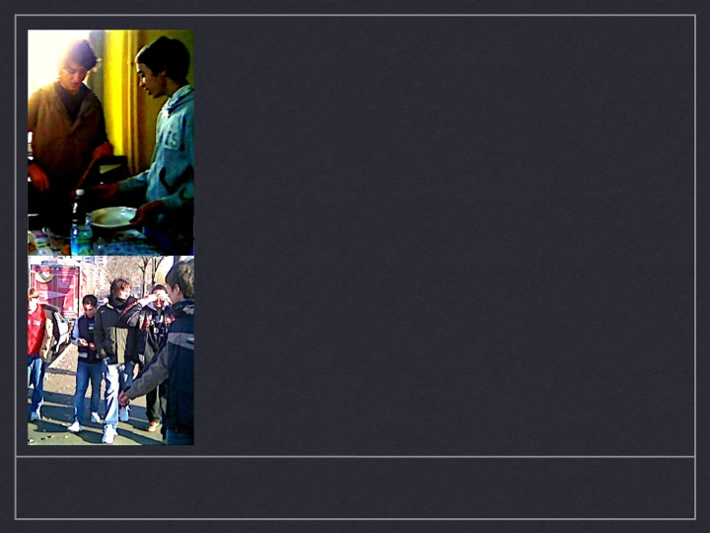
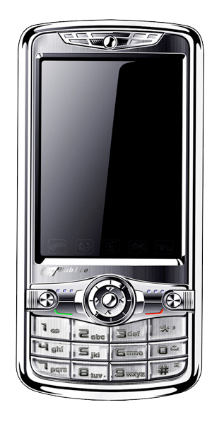
When the gen of his unit decided to RENEW THE PACT OF MUTUAL LOVE every morning before going to school by texting one another, DAVIDE was one of the most faithful in doing it.
I RENEW THE PACT WITH YOU

Slide 21
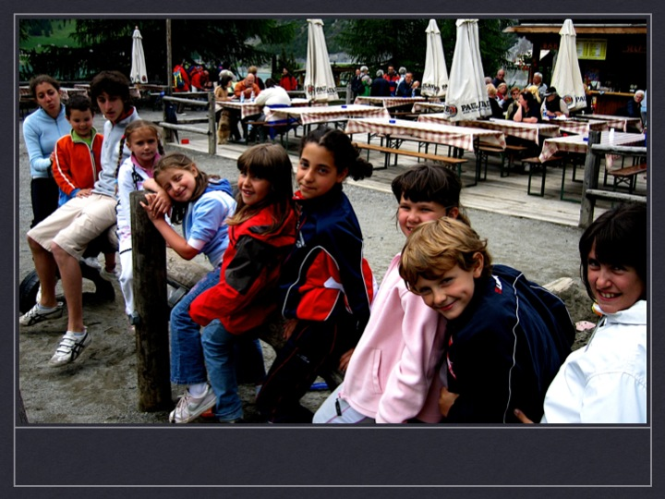
THE PACT:
I JUST REMEMBERED. I WANT TO RENEW IT WITH YOU.
I remember one time I was in the car, rushing to get to work because I was late. I was preoccupied with a lot of thoughts and then I got his text saying "The pact: I just remembered it. I want to renew it with you.“ That whole day was totally different for me!

Slide 22
Davide went through a difficult period at one point. God seemed to be far away from him and at times he even wondered if he really existed.
He even felt like his relationship with his parents was not what it used to be.
Nothing interested him anymore. He didn’t really care about anything.
It seemed to be more than just a crisis of faith that young people sometimes go through. It was more profound, like God working in his soul.

Slide 23
But, even feeling like this, he continued doing everything he could to build a relationship with the other gen and increase the communion among them.

Slide 24
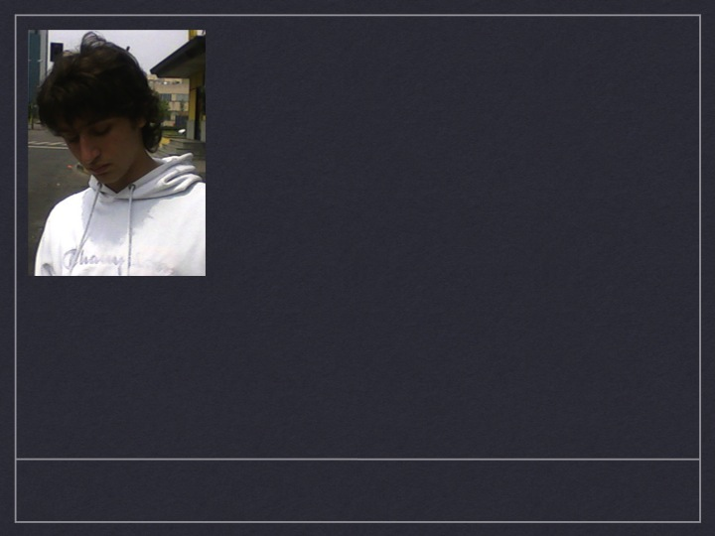
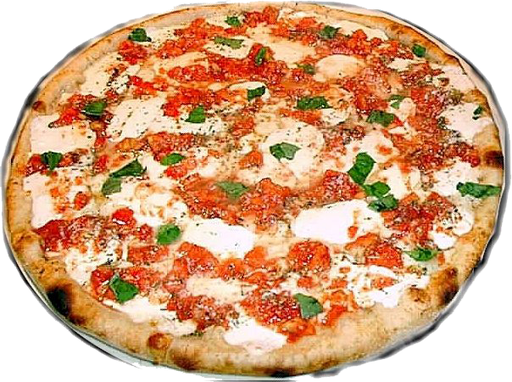
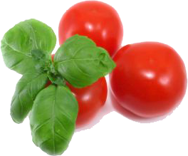
During the summer, at a certain point, he said he would like to take a break from being part of the gen life, not so much because of moving on to the gen 2 in September, but because he wanted time to process the experience he was going through. He said, “I had heard from some of the other gen my age about going through this stage, but I never knew it would be so hard!”
Even though he was going through that difficult moment, he went to the focolare and made pizza (which he learned from his dad and did very well) for the gen 4 meeting.
In October Davide asked to move into a gen 2 unit. At that same time, the symptoms of his disease worsened and he had to undergo various medical exams.

Slide 25
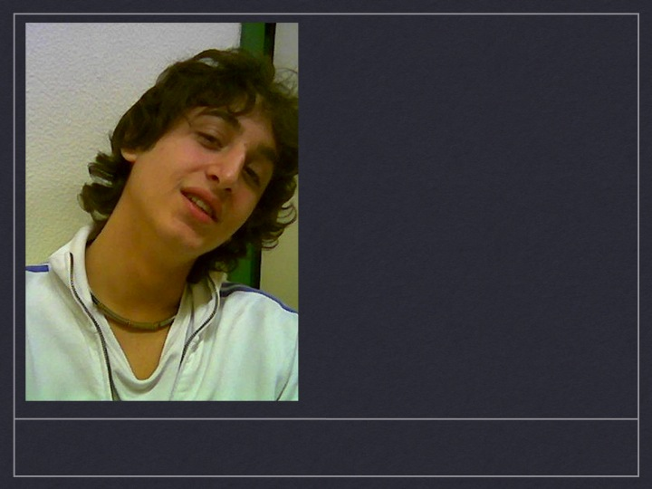
As time went on, there were gradually various "surprises" as he called them: longer stays in the hospital, the appearance of diabetes, the need for a transplant, a high fever...
It was hard to accept each one of these “surprises” as they happened, but then he would say his yes.
The last time we saw each other he pointed to his mom and said: “Her love is a very special medicine that heals better than anything else!”
( Daniel – his gen 3 assistant )

Slide 26
THANKS DAVIDE!!!

Slide 27
Mark (Italy)
John Victor (Brazil)
Christopher (Panama)
Davide (Italy)
André (Portugal)

Slide 28
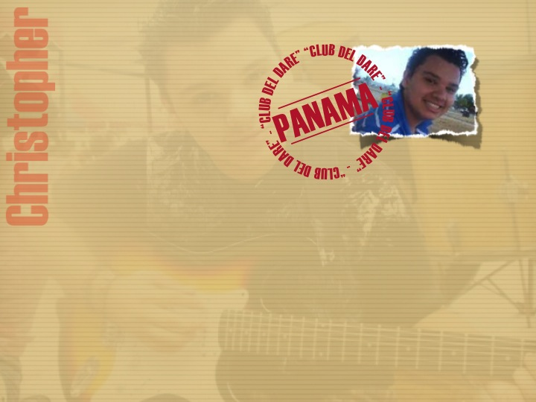
From the
“Club of Giving” to Paradise

Slide 29
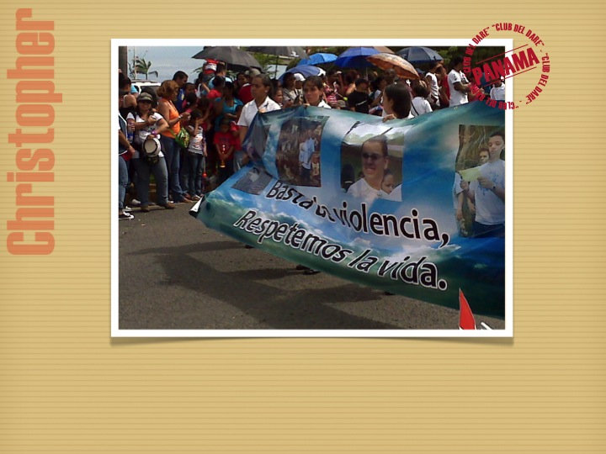
Christopher
PANAMA

Slide 30
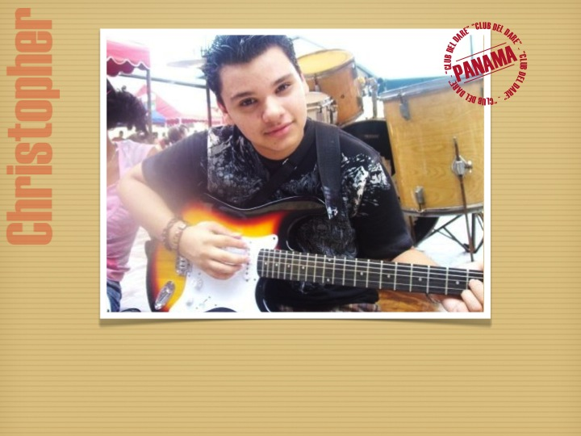

“Christopher Amaya was a 17-year-old Panamanian with the ‘gift of being a real person.’ He died tragically but he left behind a trail of love for many teens and young people to follow.”
(taken from an article in a Panamanian newspaper)

Slide 31
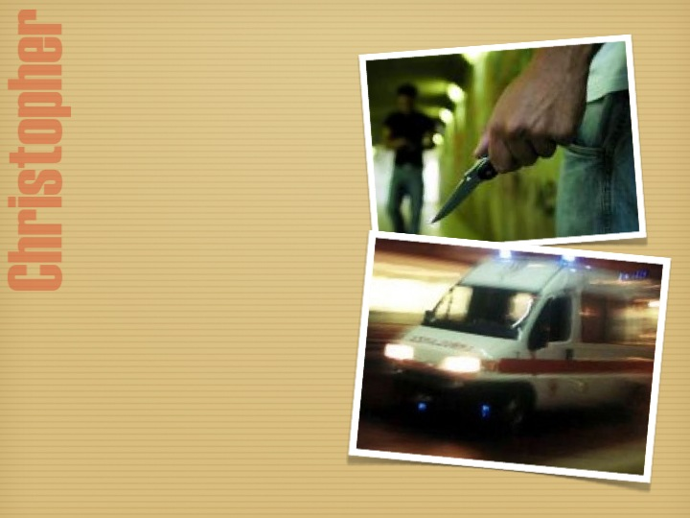
On October 31, 2010, Christopher was the victim of a robbery. He was on his way home when a thief stabbed him in the chest and stole his cell phone.
Shortly before dying he was able to speak with his mother and even though he realized that his departure for heaven was near, he tried to calm her with a smile.

Slide 32
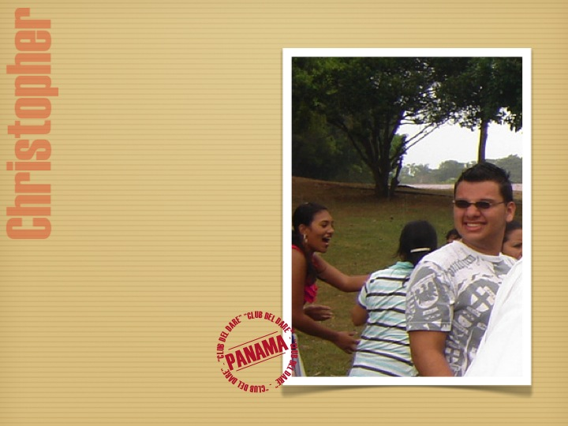
In 2005 he met and got involved with the “club of giving.” Right away he committed himself to work on all the various projects the youth sponsored in order to spread the culture of giving and to help people who are very poor. He was one of the best workers.

Slide 33
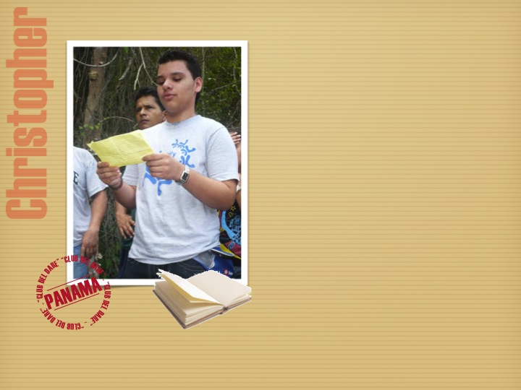
After the trial year, he received his membership card in the club during an official ceremony.
It was a great joy for him, and he took the commitment very seriously, aware that he was making choice for life.
He pledged himself to live the Gospel together with the gen 3 of his city.

Slide 34
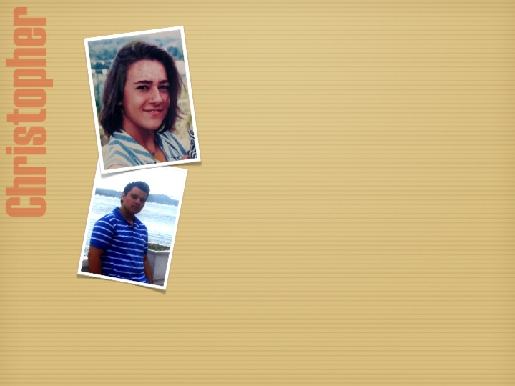
“Christopher's life reminds me of Chiara Luce’s,” is what Francisco of Panama said after he participated in the ceremony for her beatification in Italy.
And he added: “Both were young, simple and with a normal life, but they looked for God in everything. They were two teens who brought God to everyone they met and who, with a smile, transformed your life."

Slide 35
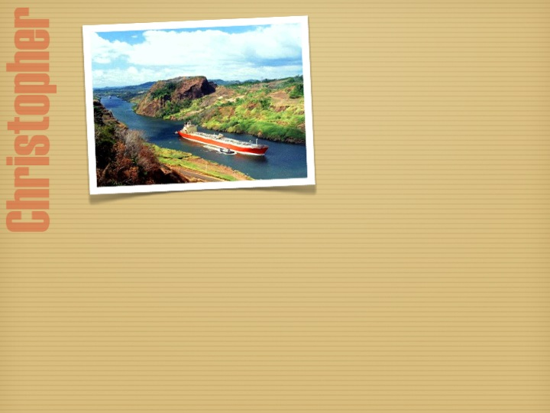
Christopher was only a year old when in 1994 this family moved to Panama, a country that became their second homeland.
His parents separated when he was still very little, and despite the pain of his family situation, he endured it and became a point of reference for both of his parents. He got to know the spirituality of the Focolare and understood from it that behind every sorrow is a presence of Jesus in his greatest suffering when he cried out his abandonment on the cross. Christopher knew that this sad situation in his family was "his own special countenance of Jesus Forsaken.”

Slide 36
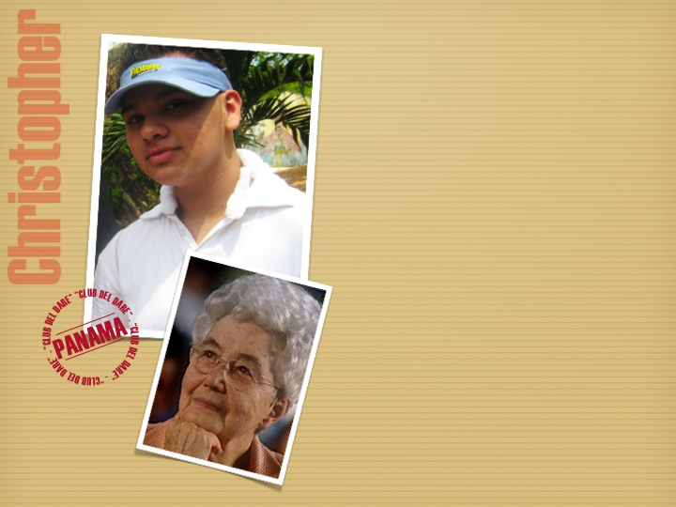
The "club of giving" at his school was the way he first got to know the Focolare and Chiara.
He quickly became a leader in this activity that promotes the culture of giving and the values of peace and solidarity. Gradually he learned about the gen 3 and became one of them.
He established a personal relationship with Chiara and always considered her as his mother and his friend, a person he could turn to and trust to lead him to the truth.

Slide 37
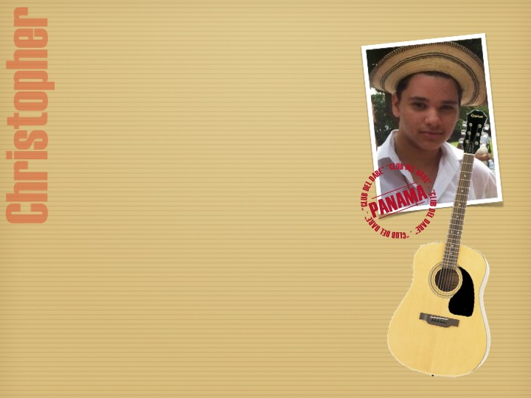
One day when he was living a difficult time in his family he confided, "My mother Chiara taught me to really forgive others and love them."
He often spoke with the other gen about
his life and his choices, because he felt he could experience with them the presence of Jesus, who had promised, "Where two or three are gathered in my name, there am I among them" (Mt 18:20)
During a very profound sharing, he confided in the others that he felt God was calling him to leave everything and follow Jesus, even though he didn’t know yet in which way.

Slide 38
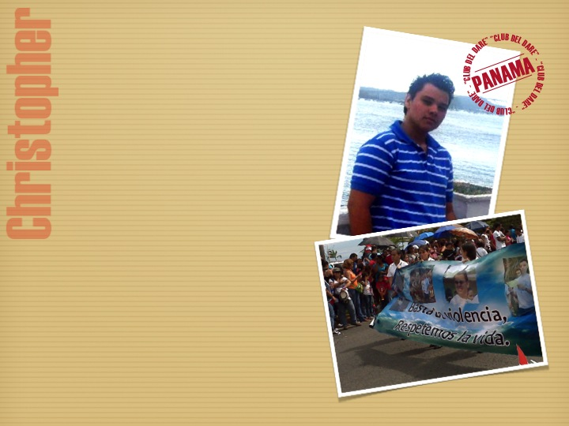
Christopher participated actively in his parish and recently he had been working to unite the various youth activities. Many young people remember him as one who built bridges among the various parish groups so as to bring unity among all.
This year he was chosen to be part of the honor guard at the national festival. It is a privilege that the schools grant only to the best students. They wear the tricolor arm bands and carry the flag of Panama.
Christopher was killed before he could participate in the parade but his friends wanted him to be present anyway, so they carried a large banner with his picture on it and a appeal to stop violence.

Slide 39
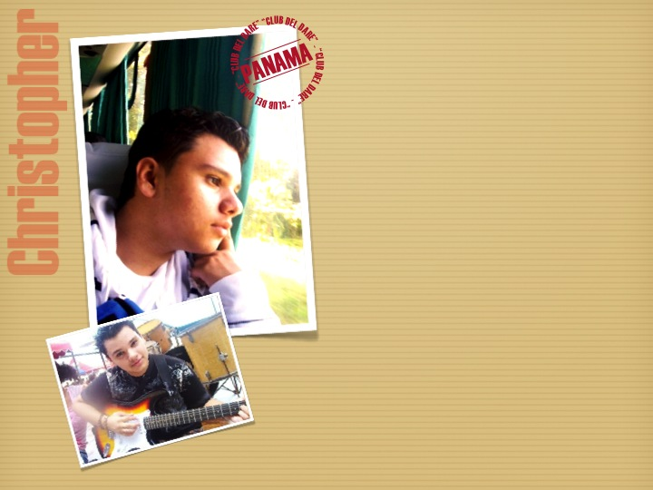
"I can testify to his yes to God,” said Sharlin, a friend of his, “and I assure you that he loved right to the very end. Who of us, stabbed in the chest, would have the courage to say, “Mom, be calm, don't be afraid”?
Many messages came in from all over the world and were read at his funeral.
His mother said, “I am happy because I realize how good my son was! All the good that he sowed will continue to grow in everyone who knew him and who follow the example of his life.”

Slide 40
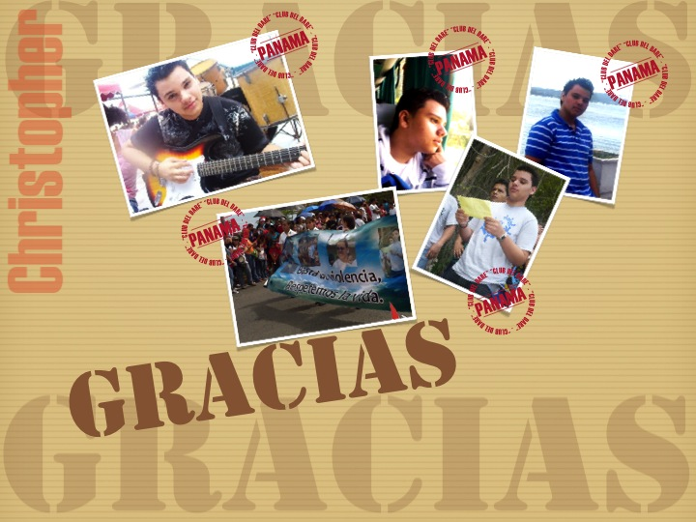

Slide 41
Marco (Italy)
João Victor (Brazil)
Christopher (Panama)
Davide (Italy)
André (Portugal)

Slide 42
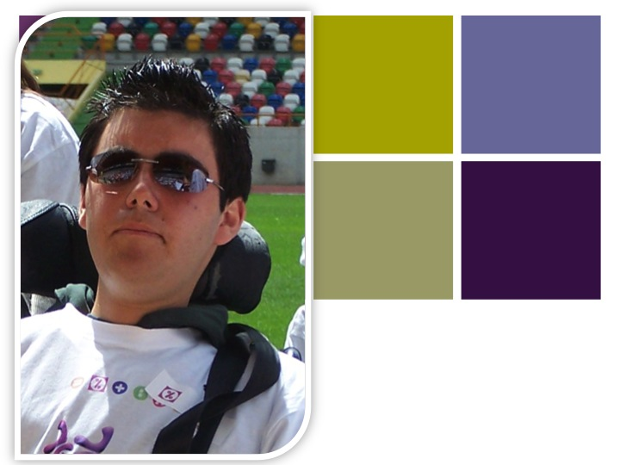
André
Portugal

Slide 43
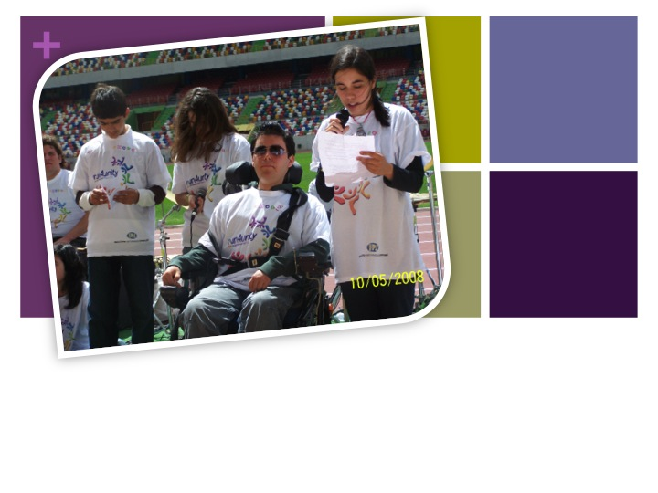
There were five of us in our gen unit and it was our good fortune to have André with us. For many years he suffered from a serious illness, but being with him was always a great joy for all of us.

Slide 44
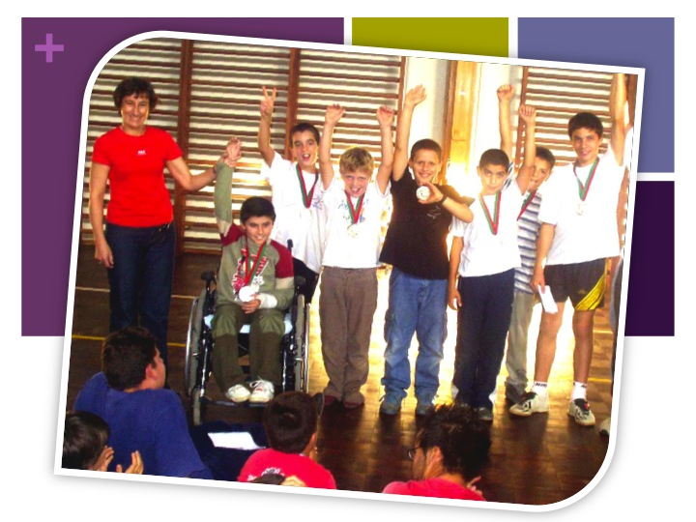

Slide 45
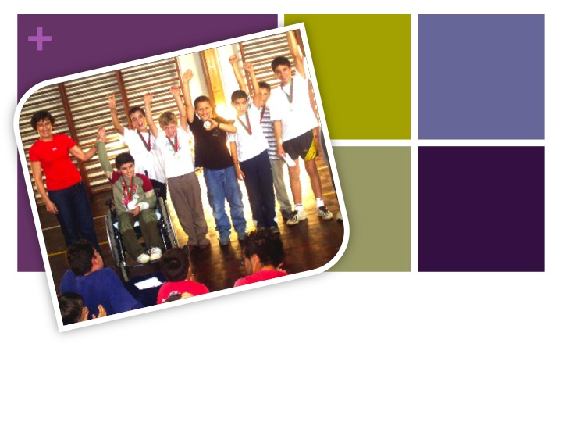
There were times when our unity was not at its best and the one who felt this the most was Andre’. He noticed it right away because it would have an effect on his schoolwork and he wouldn’t do well in class.

Slide 46
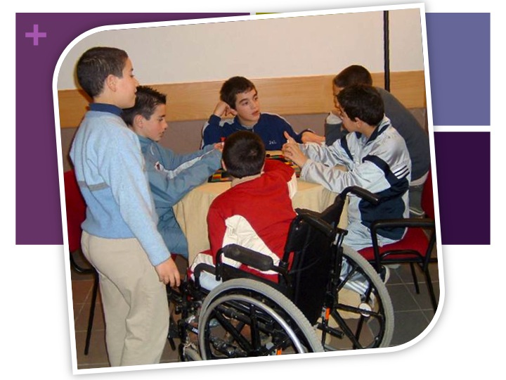

Slide 47
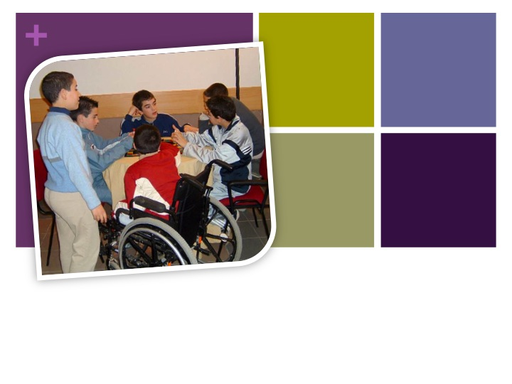
Instead, when we had a great unity among us, he could face even the hardest exams with determination because he felt the support and unity of all of us. At those times the exams went well for him.

Slide 48
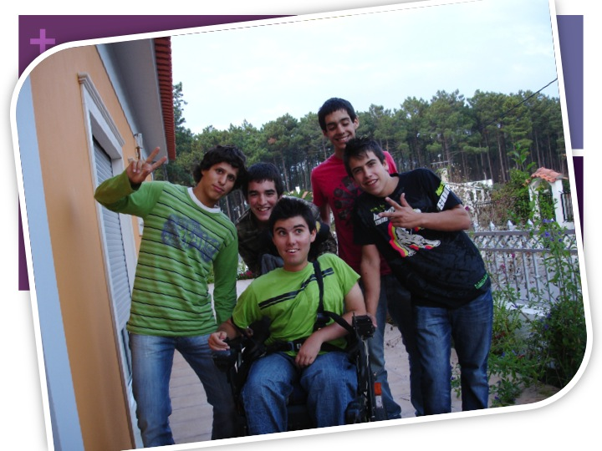

Slide 49
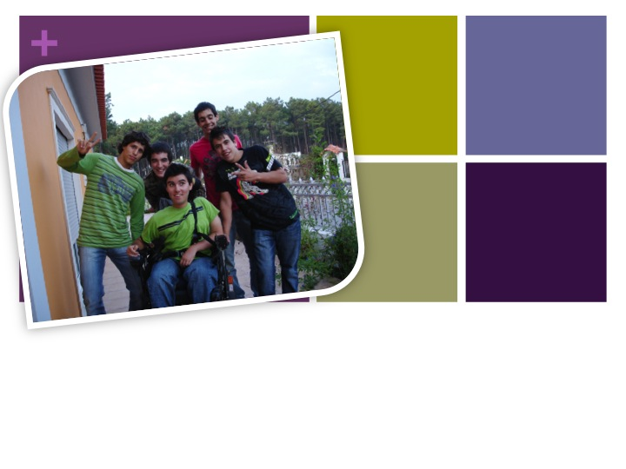
He often had to go to the hospital for treatments, and every time we went to visit him to keep Jesus in the midst with him and bring him joy. He was always very happy when he saw us because he felt that he was not alone, and we left with twice as much joy as we had brought him.

Slide 50
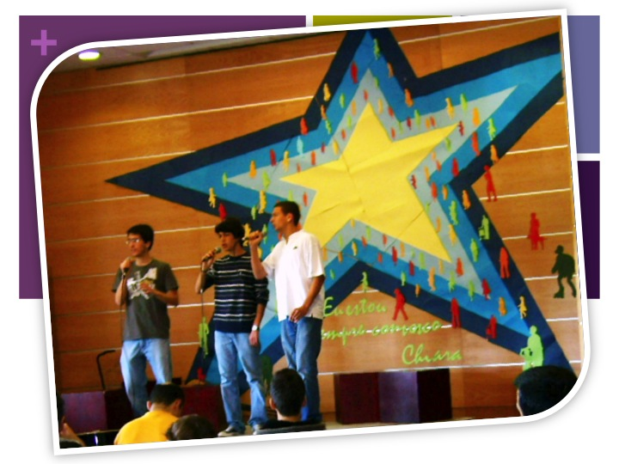

Slide 51

Because of his illness, André wasn’t able to do all the things that we could do, he couldn’t run or play sports... but this helped us to appreciate more all the little things we can all do.

Slide 52
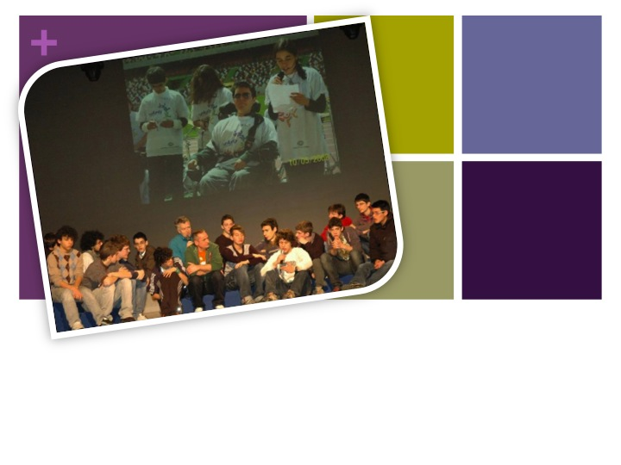
His way of facing his limitations helped us to get beyond every small or big problem we might have. Seeing how he faced suffering and difficulties was for us a great example and an incentive to keep going along our path.

Slide 53
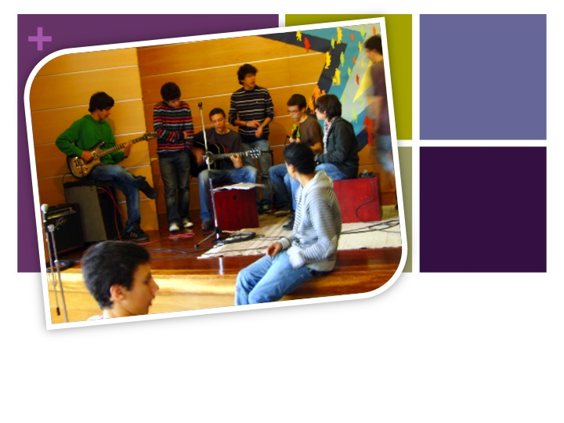
Andre’ wanted to attend the National Gen 3 Congress in the permanent Mariapolis of Arco Iris. "From the day he came home, he was a different André,” his family told us. “That strong experience of Jesus in the midst changed him profoundly."

Slide 54
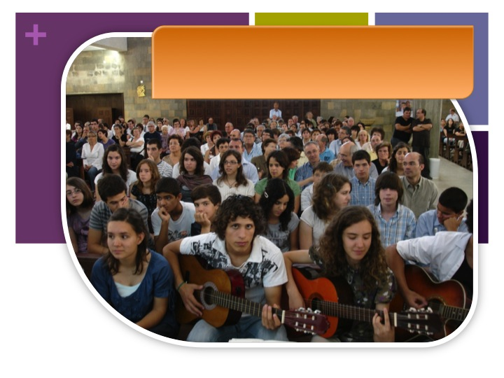
The church was packed with the family of the movement.
“The festival [funeral] of his meeting with Jesus”

Slide 55
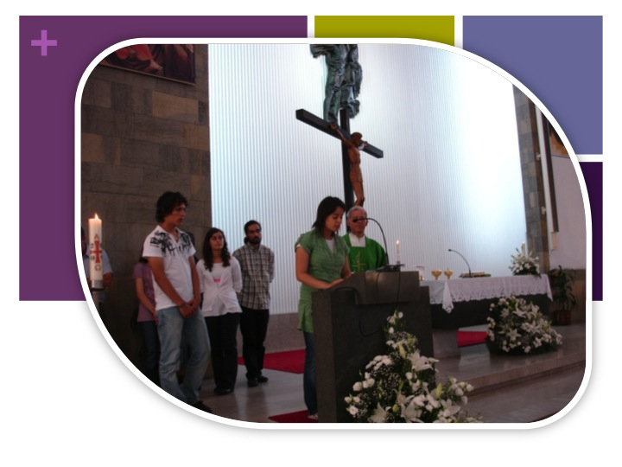
The gen 3 read the intentions.

Slide 56
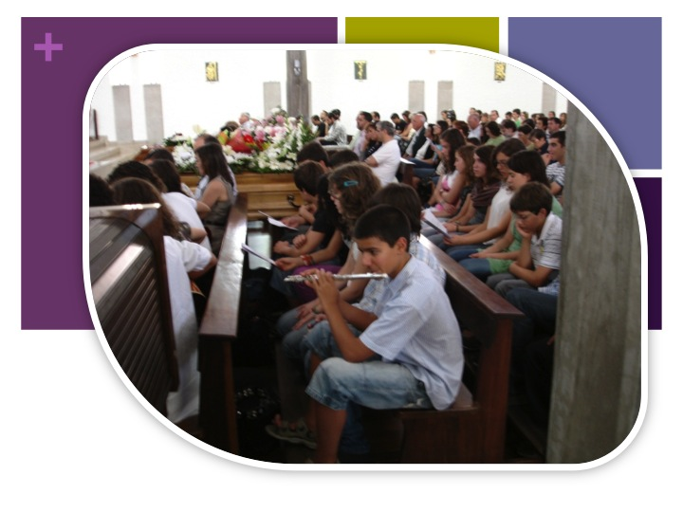
They also prepared all the songs.

Slide 57

A white flower, symbol of his baptismal innocence, was placed on the casket.

Slide 58

Flavio, the “white” of his unit, read a brief story of his life and experiences.

Slide 59

Jorge, his father, said with emotion: “During these days some of you have asked me what it was like to take care of Andre’ for 16 years. I can only say that it was a great privilege!”

Slide 60

When the casket was lowered into the ground, everyone applauded and colored balloons were released into the sky!!!

Slide 61

All those present experienced the "normality of the supernatural."

Slide 62


Slide 63
Marco (Italia)
João Victor (Brasile)
Christopher (Panama)
Davide (Italia)
André (Portogallo)

Slide 64

Marco Amato
A“SUPER-KID”

Slide 65

HE WAS ABLE TO COMMUNICATE VIA COMPUTER
HELPED BY HIS MOM
WITH MOM AND DAD

Slide 66

WITH HIS GEN UNIT
WITH THE GEN 3
WITH THE GEN 2

Slide 67

HE REGULARLY CORRESPONDED WITH CHIARA
WALTER KOSTNER READS A LETTER OF MARCO TO CHIARA

Slide 68

AFTER THE OPERATION ON HIS SPINAL COLUMN
MASS WAS CELEBRATED IN MARCO’S HOME

Slide 69

I think that nature gives us important lessons about life.
The ever-flowing river suggests that we never remain stopped in one place...
FROM ONE OF HIS WRITINGS

Slide 70

The sun and the moon alternate in offering us their love…

Slide 71

I know that God has filled my heart with a longing for paradise, and we find it on earth when we are in unity with nature and with one another...

Slide 72

Because the most beautiful place in the world is not really beautiful unless it radiates our mutual love.

Slide 73

HE CONSTANTLY COMMUNICATED WITH THE GEN 3

Slide 74

These days will be special if you are able to increase your love for God the Father who always loves us first. He is our Father who always offers us his help and teaches us the way to reach him, which is the whole goal of our journey. He is the only one who gives us pure joy, full light and confident hope.
To the gen 3 ( Zoldo 2007 )

Slide 75

Hi gen 4! It’s beautiful to know that you are all united together and helping each other live to the full your relationship with Jesus.
TO THE GEN 4

Slide 76

Jesus wants to grow inside each one of you, and become your special friend. He is the only one who will never abandon you, the only one who would jump into the fire to give you true joy.

Slide 77

I have in my heart great gratitude for being present at the beatification of Chiara Luce, because experiencing her life has been an immense gift for me.
MARCO WAS ABLE TO PARTICIPATE AT THE BEATIFICATION OF CHIARA LUCE

Slide 78
When I saw the crowd so full of love and everyone so united, I told myself:
"The people of God
is a reality
that is making an impact on the world!
We have to do our part
to concretize
‘that all may be one’
which is the
deepest meaning of our Ideal."

Slide 79

And you can do it by imitating Chiara Luce in her unconditional acceptance of the Father's will and by loving Jesus Forsaken, just like she was ready to love him and offer him her entire life.
MARCO WAS ABLE TO BE PRESENT AT THE BEATIFICATION OF CHIARA LUCE

Slide 80

Hello gen!
I am very happy to have you here together once more,
even though it’s the last time we will meet as a unit...
But I know that we will never abandon one another,
because Jesus in the midst
will keep us united and faithful to our Ideal, which,
as Chiara Luce
reminds us, comes before everything else.

Slide 81

We are called to do the will of God and to help one another to live as brothers and sisters who want to walk together along the Holy Journey.

Slide 82

... Let's give to the world the beauty of living colors just as we will find them in heaven, where the rainbow no longer need tears in order to show its colors.

Slide 83

Now I have to say goodbye!
Our greatest gift is to know that nothing and no one can take away God's love for us.
All my unity to
each and all!
MARCO - AMATO

Slide 84

MARCO AMATO BETTIOL
JUNE 24,1992 – OCTOBER 15, 2010

Slide 85
Marco (Italia)
João Victor (Brasile)
Christopher (Panama)
Davide (Italia)
André (Portogallo)

